Slide 1

Agent-based modeling of an epidemic
Centre for
Educational Development
Notes:
See speak + storyboard for video at:
https://docs.google.com/document/d/1-Y_PeO3UXHfrTS_SYd5FA4mTE2rKcft5_H8yP__Rh2w/edit#
Tjek logoplacering?

Slide 2
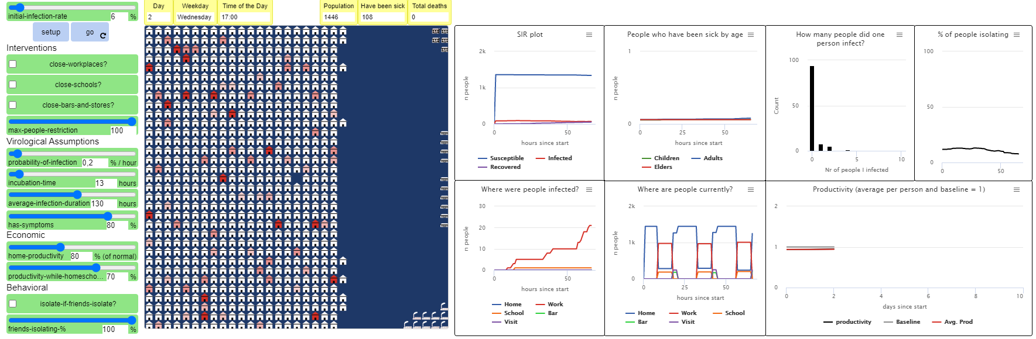
The University curricular unit
Theory of Science, BA and MA (2-hour lecture & workshop)
What are models, and how do they embody ‘theory’?
What are the limitations of models, and how does that affect what we can know with a model?

Slide 3




A TYPICAL day in an ADULT agent’s life
WEDNESDAY:
8:00 – Go to workplace
17:00 – Go to a bar with friends (if in a social mood)
20:00 – Go home
SATURDAY:
13:00 – Go to a friend’s house to hang out
17:00 – Go home
Notes:
(pedagogical explanation of how the model runs, agent behaviour, different buildings, etc)

Slide 4
What big question does the model answer?
What are the best strategies for balancing human life with the economic impact of a lockdown?
The simulation is a virtual lab which allows us to experiment with the epidemic
It may not give specific answers, but it helps us better understand the complex system
Notes:
slide

Slide 5
limitations
Remember: the simulation is a simplification of reality
What does it NOT include?
What else could be important? What would you add?
What about…
The psychological wellbeing of agents?
Other public spaces such as public transport?
How do these limitations affect what we can know with the model?

Slide 6
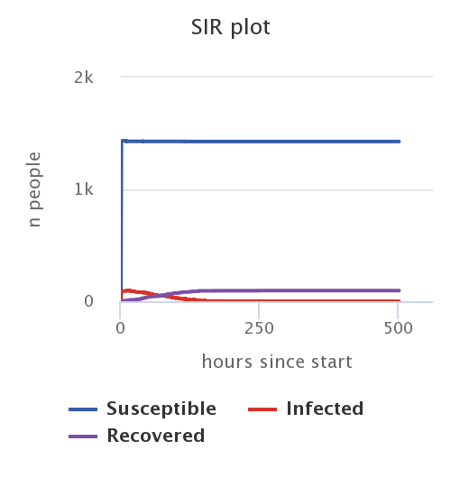
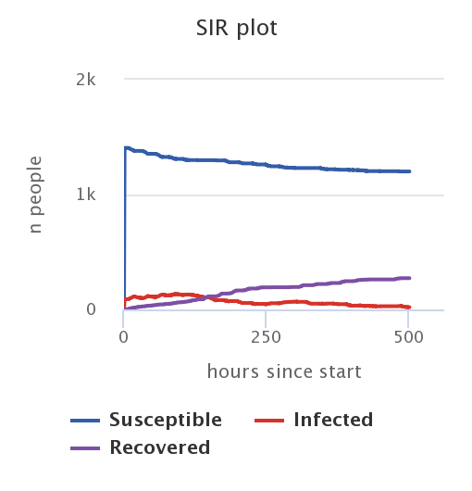
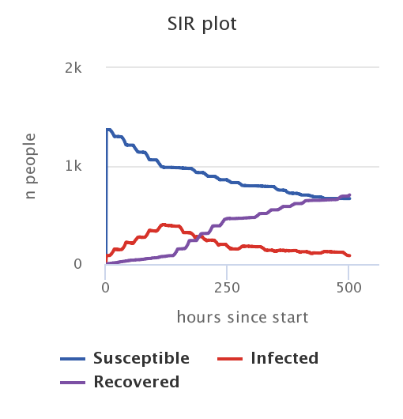
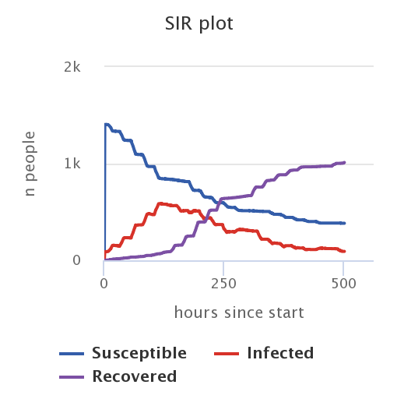
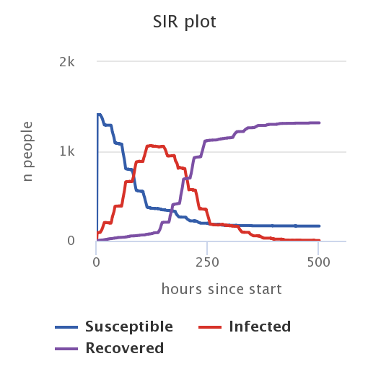
Comparing runs: % with symptoms
Varying the percentage of infected agents that develop symptoms:
100%
75%
50%
25%
0%
Notes:
(also look at other plots, show in model run: productivity plot and % of people isolating. It’s all connected!
Maybe mention: every run is different, so slight variation (these aren’t average plots, but just plots from single runs)
All other settings kept constant: initial rate 6%, no interventions, max people 100, 0.2% inf, 12 hours inc, 130 hours avg dur, isolate if friends isolate OFF

Slide 7




The causal chain: on agent-level
Agent develops symptoms
Agent self isolates and stops spreading the virus
An agent gets infected
INCUBATION TIME
Agent does not know they are sick, but can still spread the virus
Agent does NOT self isolate and may continue spreading the virus
Agent does NOT develop symptoms
Notes:
Explain causal chain

Slide 8
Try it out for yourself!
Find download link to the simulation on this page

Slide 9
Contact information
Arthur Hjorth – head of the team
arthur@mgmt.au.dk
Center for Hybrid Intelligence
mgmt.au.dk/center-for-hybrid-intelligence/
sherson@mgmt.au.dk
Centre for Educational Development
ced.au.dk
ced@au.dk
Notes:
If you are curious about how we use this to build fun and engaging learning activities for students, we go into more depth in the videos [below/ link link].
And if you are curious about using agent-based models in your own teaching, please do not hesitate to get in touch! You can also get more information about agent-based models and how it can be used in teaching on the digital curriculum [insert link to correct page here].

Slide 10
Centre for
Educational Development

Slide 11
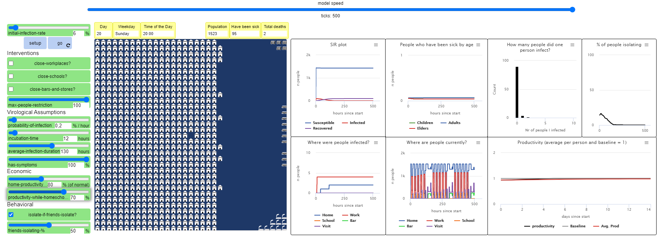
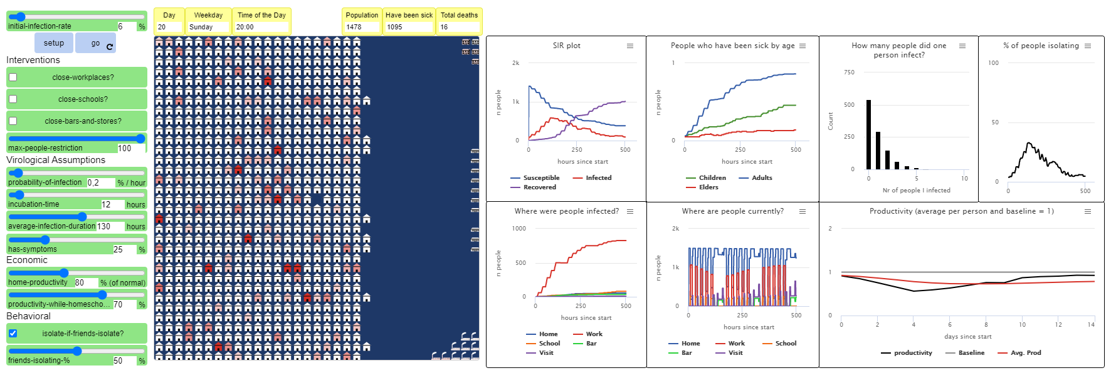
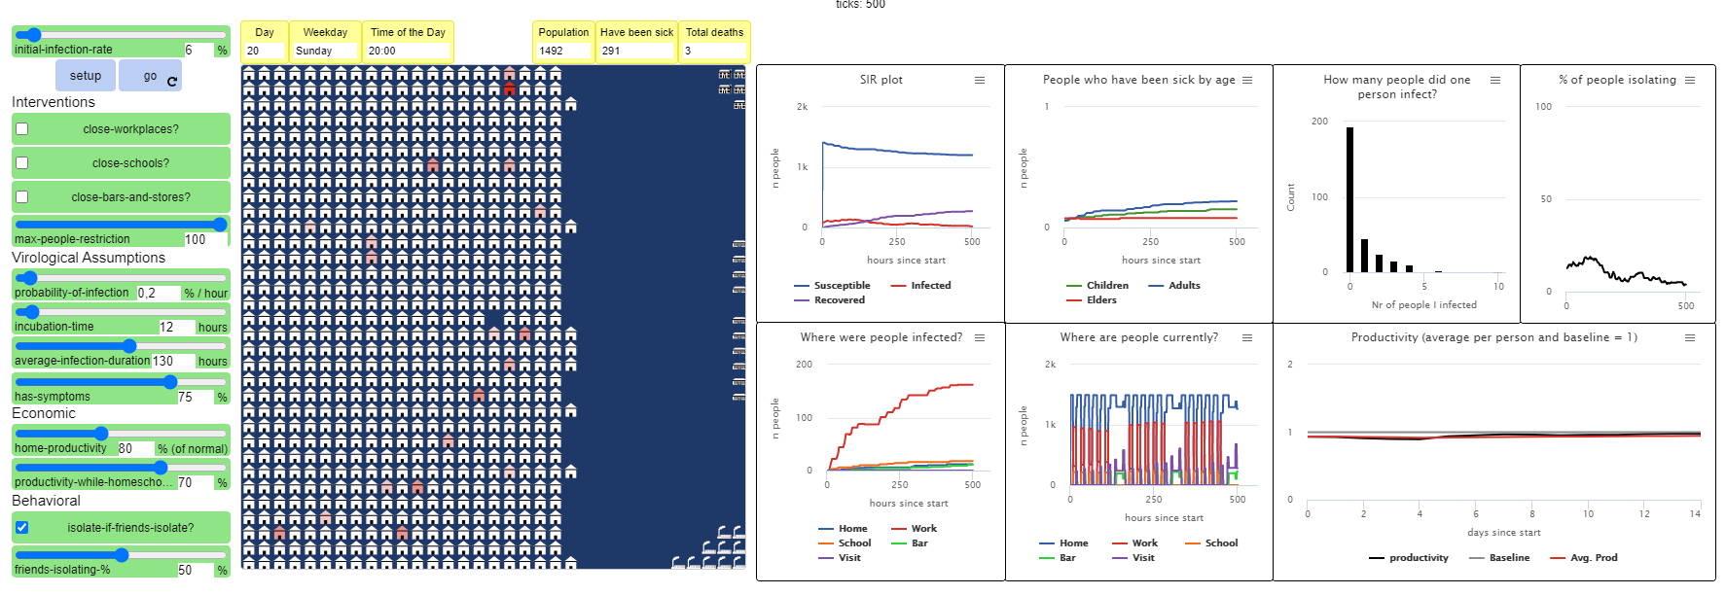
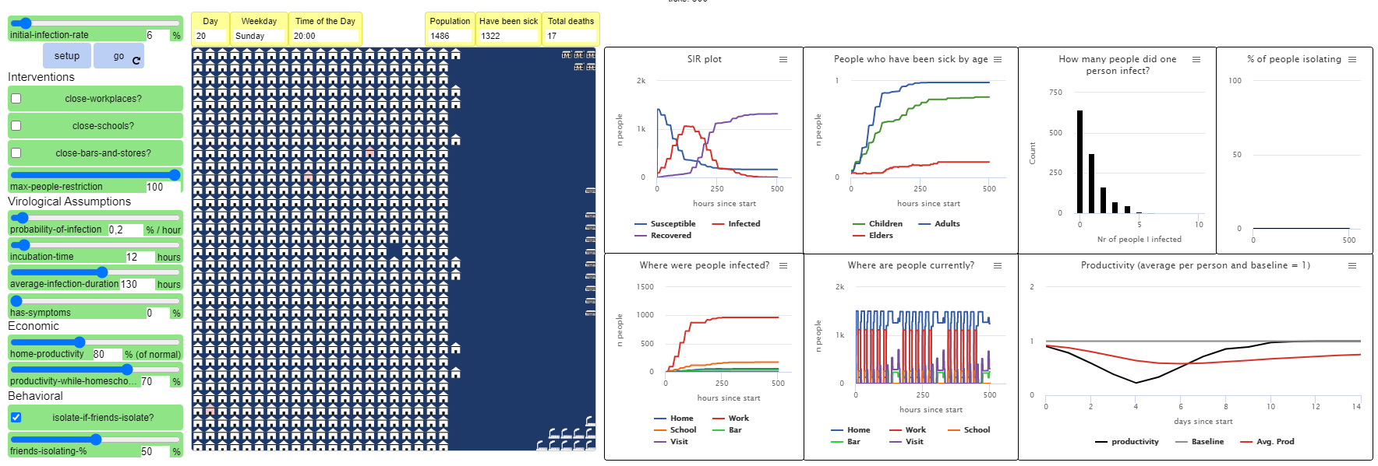
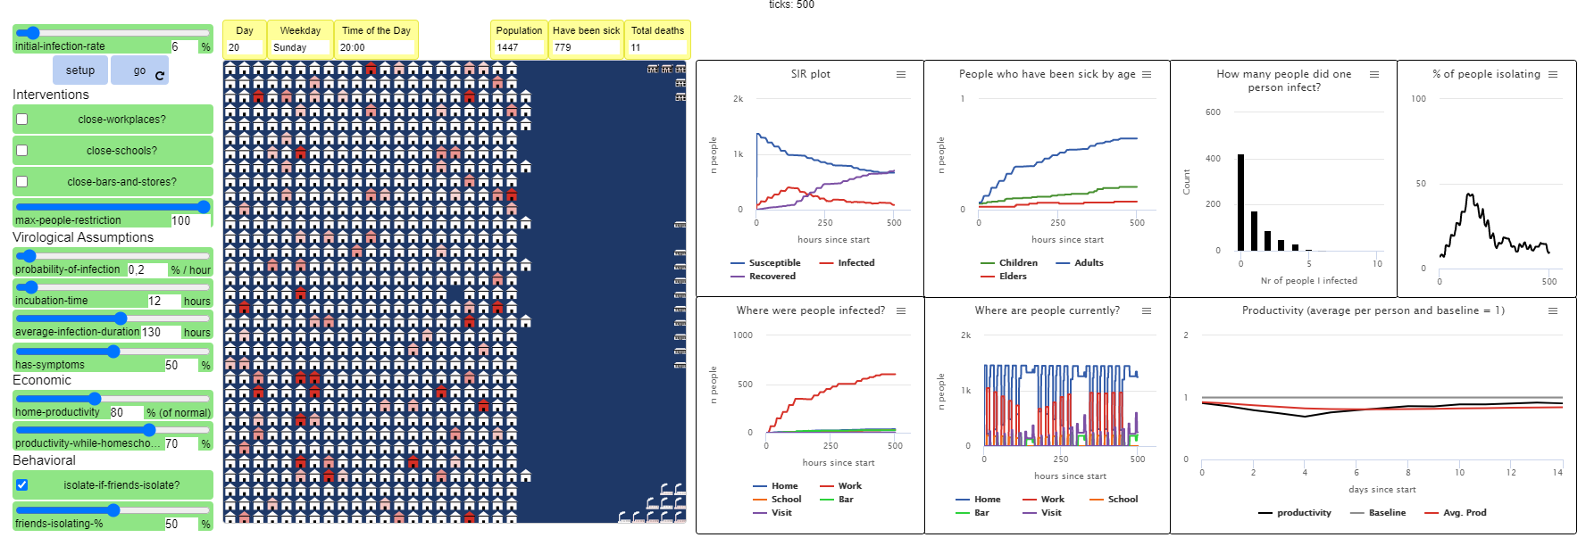
Notes:
(med 0.2% inf per hour, varying %-with-symptoms) (just for reference)

Slide 12
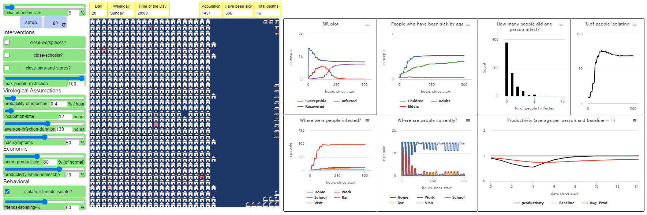
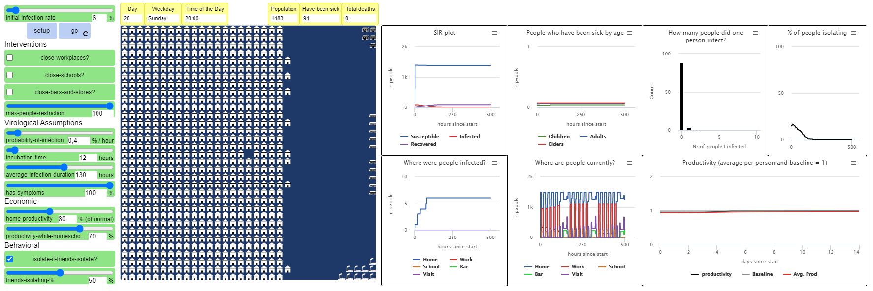
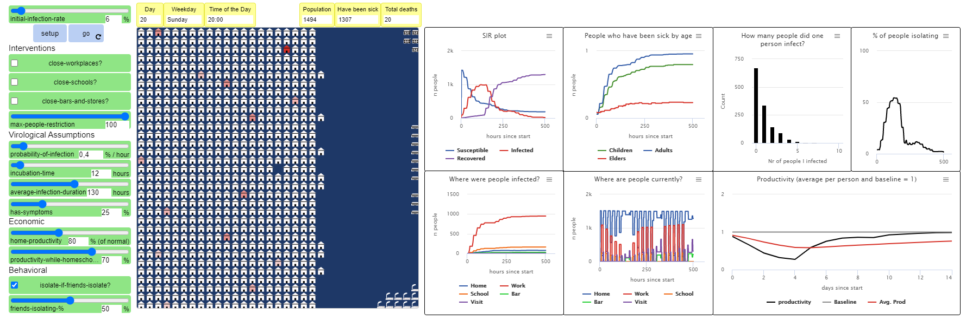
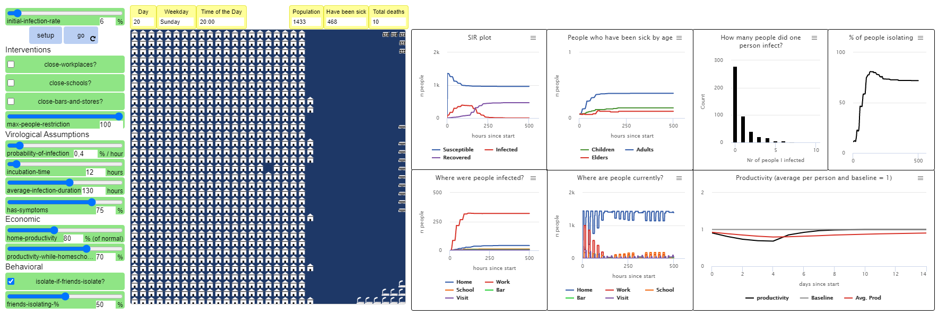
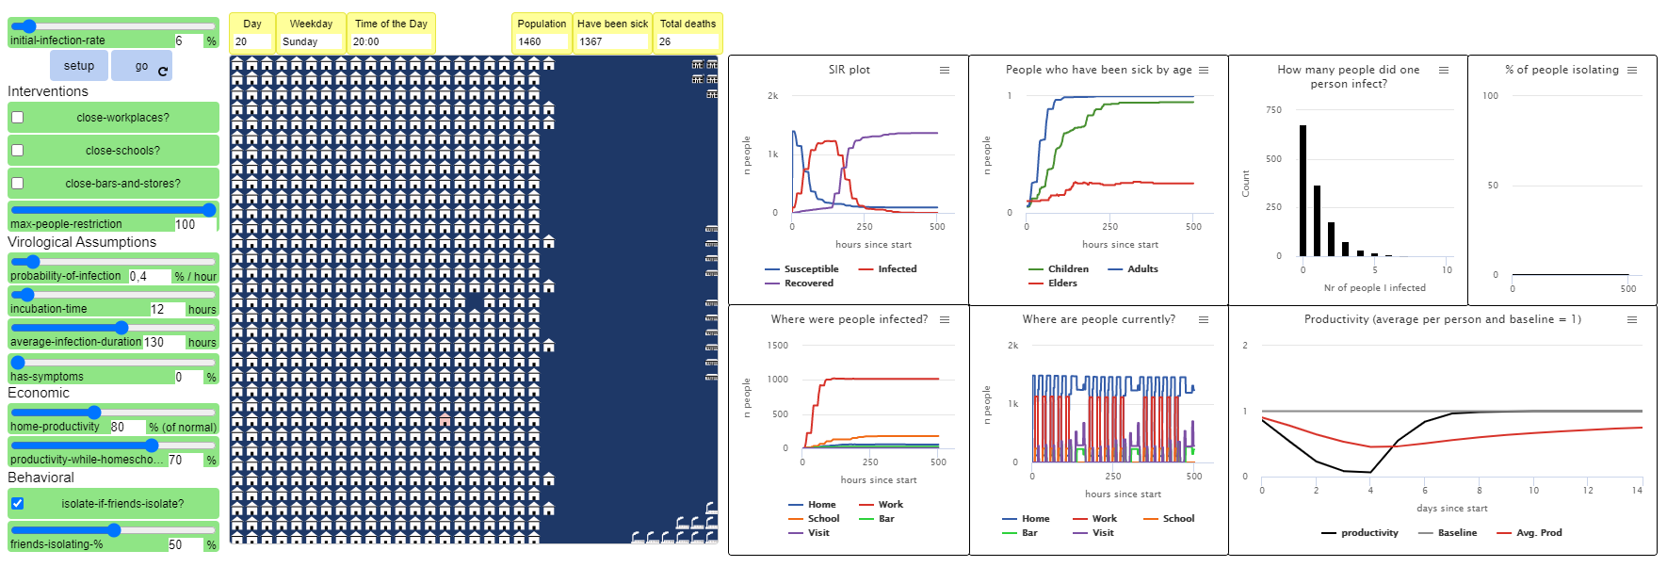
Notes:
(med 0.4% inf per hour, varying %-with-symptoms) (just for reference)

Slide 13
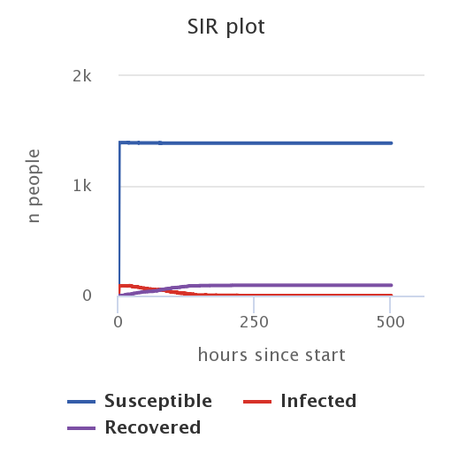
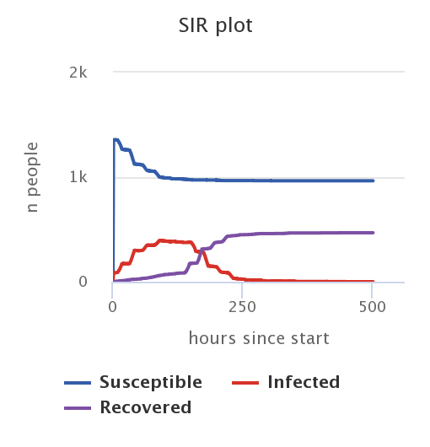
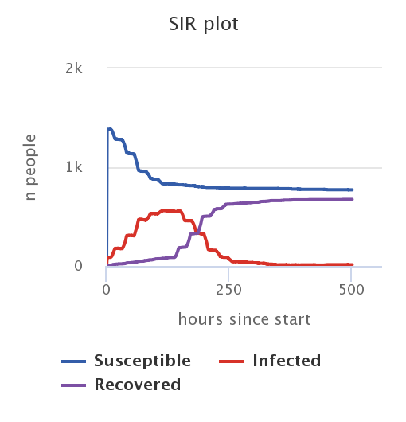
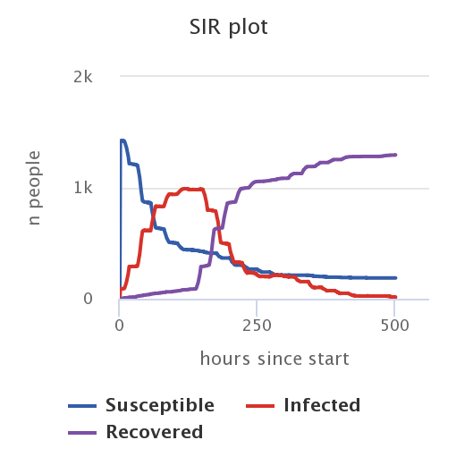
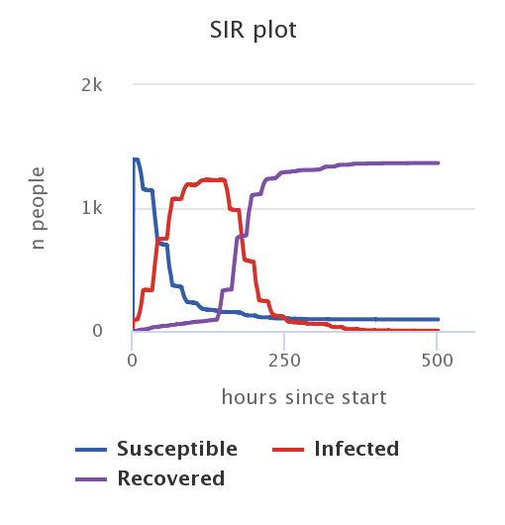
Comparing runs: % with symptoms
Varying the percentage of infected agents that develop symptoms (0.4% inf-pr-hour):
100%
75%
50%
25%
0%
Notes:
(DON’T INCLUDE THIS SLIDE)
(NU MED 0.4% inf per hour!)
All other settings kept constant: initial rate 6%, no interventions, max people 100, 0.4% inf, 12 hours inc, 130 hours avg dur, isolate if friends isolate OFF

